Slide 1

MobilePlantViT
Mobile-Friendly Plant Disease Classification
This project develops a lightweight, efficient deep learning model for accurate plant disease detection from leaf images. Designed for real-time diagnosis on mobile and edge devices, it brings AI-driven agricultural intelligence directly to farmers in the field.
Presented by: Additi Naik, Vaishnavi K, Varun Tej Reddy, Ashwanth Reddy, Sai Krishna (G637)
Mentor: Shilpa Gupta

Slide 2
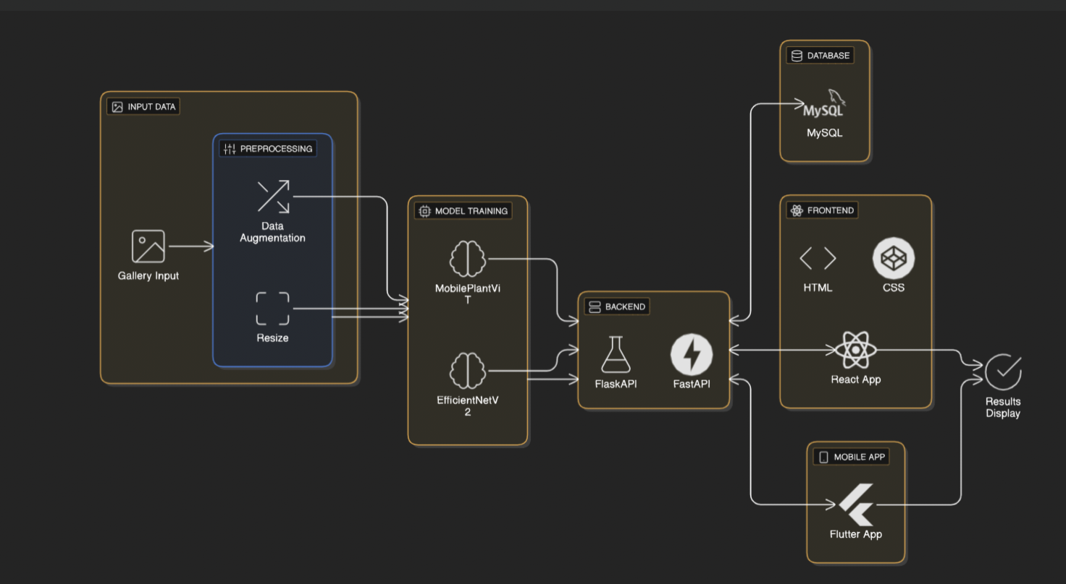
ARCHITECTURE DIAGRAM

Slide 3

Technology Stack & Tools
Languages & Frameworks
Programming languages
Deployment Tools
VS Code
Jupyter
Google Colab
Python (Model + Backend),
JavaScript (React)
PyTorch, timm, torchvision
FlaskAPI
HTML , CSS
TensorBoard: Training Metrics
GitHub: Version Control
Database & Deployment Platform
MYSQL (for storage and results)
Cloud Server Backend
Flutter

Slide 4


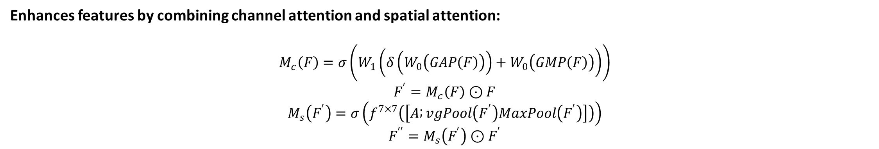



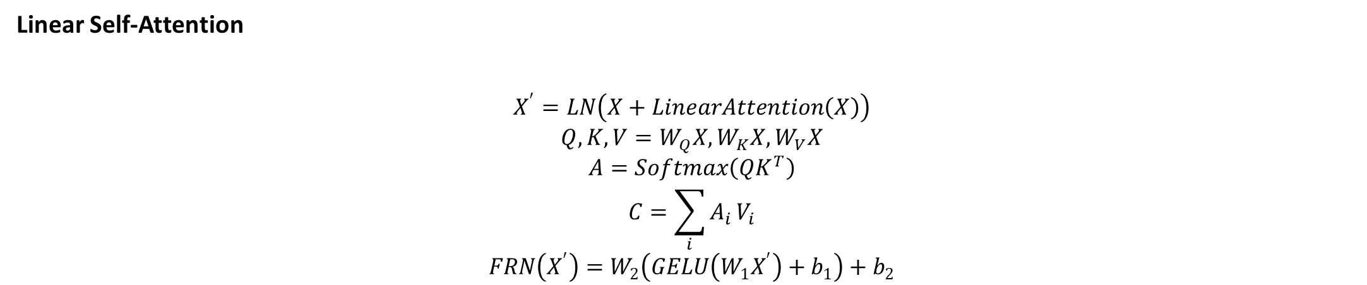

Mathematical Foundation
Enhances features by combining channel attention and spatial attention:
$$M_{c}\left(F\right)=σ\left(W_{1}\left(δ\left(W_{0}\left(GAP\left(F\right)\right)\right)+W_{0}\left(GMP\left(F\right)\right)\right)\right)$$
$$F^{′}=M_{c}\left(F\right)⊙F$$
$$M_{s}\left(F^{′}\right)=σ\left(f^{7×7}\left(\left[A ; vgPool\left(F^{′}\right)MaxPool\left(F^{′}\right)\right]\right)\right)$$
$$F^{′′}=M_{s}\left(F^{′}\right)⊙F^{′}$$
Linear Self-Attention
$$X^{′}=LN\left(X+LinearAttention\left(X\right)\right)$$
$$Q,K,V=W_{Q}X,W_{K}X,W_{V}X$$
$$A=Softmax\left(QK^{T}\right)$$
$$C=\sum_{i}{A_{i}}V_{i}$$
$$FRN\left(X^{′}\right)=W_{2}\left(GELU\left(W_{1}X^{′}\right)+b_{1}\right)+b_{2}$$
:
Classification Head:
$$P=Softmax\left(WZ+b\right)$$

Slide 5
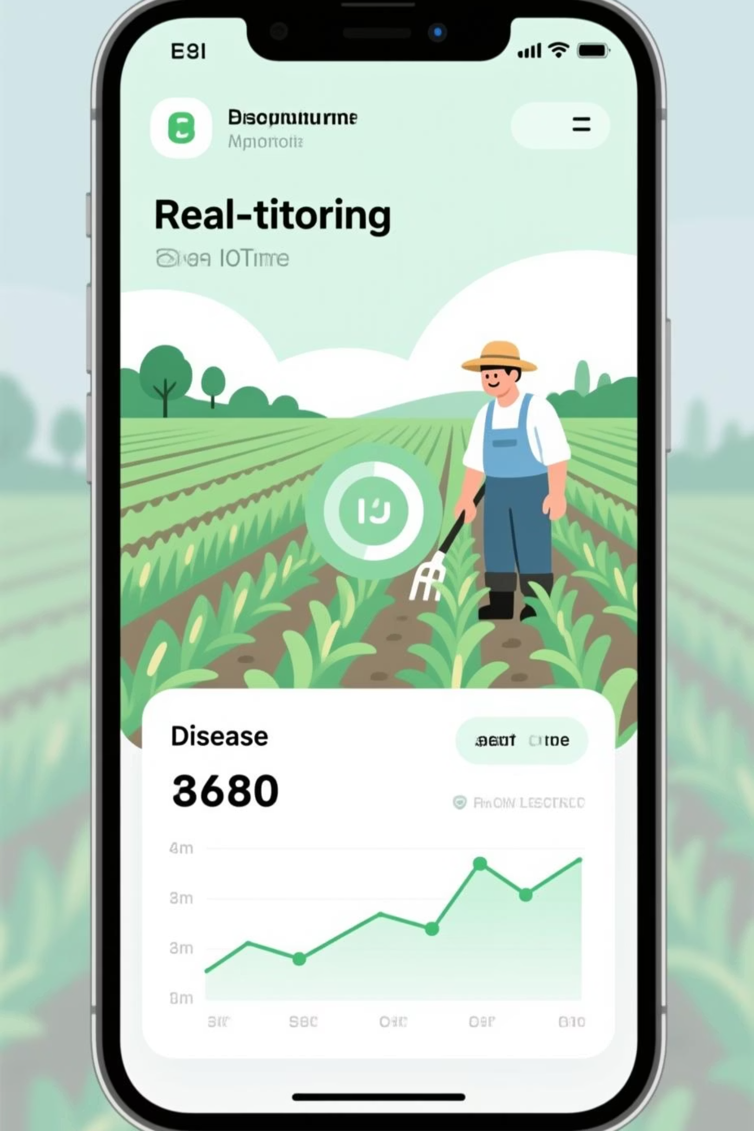
Our Work: Innovations & Insights
1
2
Key Improvements
Technical Insights
We used the models MobilePlantViT EfficientNetV2 for enhanced accuracy and faster inference. Integrated FastAPI, React, Flutter, and MySQL for seamless end-to-end deployment across web and mobile platforms.
Mastered CNN and VisionTransformer architecture , integration for mobile-scale deployment. Gained practical expertise in API development, database management, and cross-platform application design.
3
Real-World Impact
Enables farmers to diagnose plant diseases instantly using mobile devices. Supports IoT and drone-based monitoring systems for precision agriculture and early disease intervention in crop fields.

Slide 6
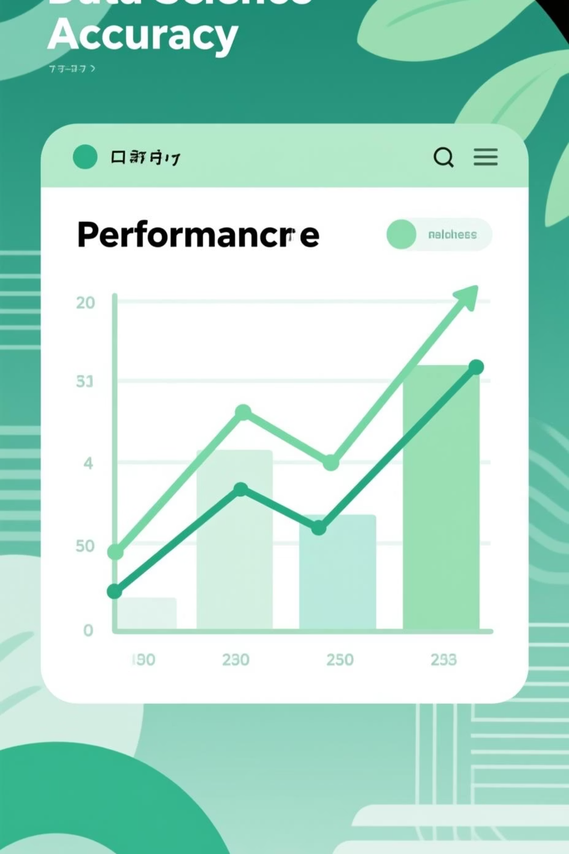

Results, Challenges & Limitations
Performance Results
Challenges Addressed
Achieved 95.4% classification accuracy
Overfitting mitigated via data augmentation
Exceeds original paper baseline
Model size reduced with EfficientNetV2
Optimized inference latency
Regularization techniques applied
Current Limitations: Model performs optimally under controlled lighting conditions with clear leaf specimens. Currently supports a limited crop variety; expansion requires additional training data for diverse plant species.

